Slide 1

National Honor Society
January 2026 - 5th Meeting

Slide 2
Leadership Contact
President: Lily Arnold - lilyba@madisoncity.k12.al.us
Vice President: Krishnam Maisuria - krishnamcm@madisoncity.k12.al.us
Sponsor: Mr. Thomas - jlthomas@madisoncity.k12.al.us

Slide 3
New Officers!
Secretary: Tabytha Hartland - tabythajh@madisoncity.k12.al.us
Parliamentarian: Prakya Velagapudi - prakyav@madisoncity.k12.al.us
Treasurer: Clara Maehlmann - claraem@madisoncity.k12.al.us
Historian: Aneesh Maruvada - aneeshcm@madisoncity.k12.al.us

Slide 4
Do not forget, we have a required password to submit the attendance form
Please get out your school Chromebook and open the attendance Google Form.

Slide 5
Save the time & date:
National Honor Society Picture: February 3rd, 2026 @ 9:50 AM
Aux Gym

Slide 6
NHS Oath
I pledge to maintain high scholastic standing,
To endeavor intelligently and courageously to be a leader,
To give of myself freely in service to others,
And to hold as fundamental and worthy an untarnished character.
In so doing, I shall prove myself worthy
Of a place in the National Honor Society

Slide 7
New Member Expectations
General requirements:
Be a sophomore, junior, or senior
Have a weighted GPA of 3.75 or higher
Complete 20 service hours by April and attend the Induction Ceremony in May
Complete and submit a new member application by September 12
Turn in a HARD COPY of the application to Mr. Thomas in A109.
Place your application in a large envelope
Include your updated report card and new member dues ($20) in the envelope
Print your report card from PowerSchool

Slide 8
Membership Requirements
Complete 20 service hours by April
Save all physical copies of completed service hour sheets to turn in by April
Scan and keep duplicate copies of your original service hour sheets to have for proof if the original copies get lost in the submitting process.
Maintain a weighted 3.75 GPA throughout the school year
Attend the mandatory monthly meetings
Attendance QR code is the last slide of every meeting
2 excused absences allowed
Complete the Absence Form that is sent out in the ParentSquare

Slide 9
Community Service
Must be unpaid volunteer work that helps the community
What DOES NOT count: paid work, tutoring and/or babysitting a family member
Double-dipping allowed for this year
Hours will NOT be accepted without proper documentation!
Keep all original service hour record sheets and their duplicate copies in a safe place until the April deadline.

Slide 10
Service Hours Guidelines:
20 Service hours must be completed by the first week of April
10 hour caps are placed upon the following service activities:
Summer Hours (June-July)
Weekly Religious Events
Donations
You must utilize the Service Hour Form on the JC Website
Hours not documented with supervisor signature will not be counted!

Slide 11
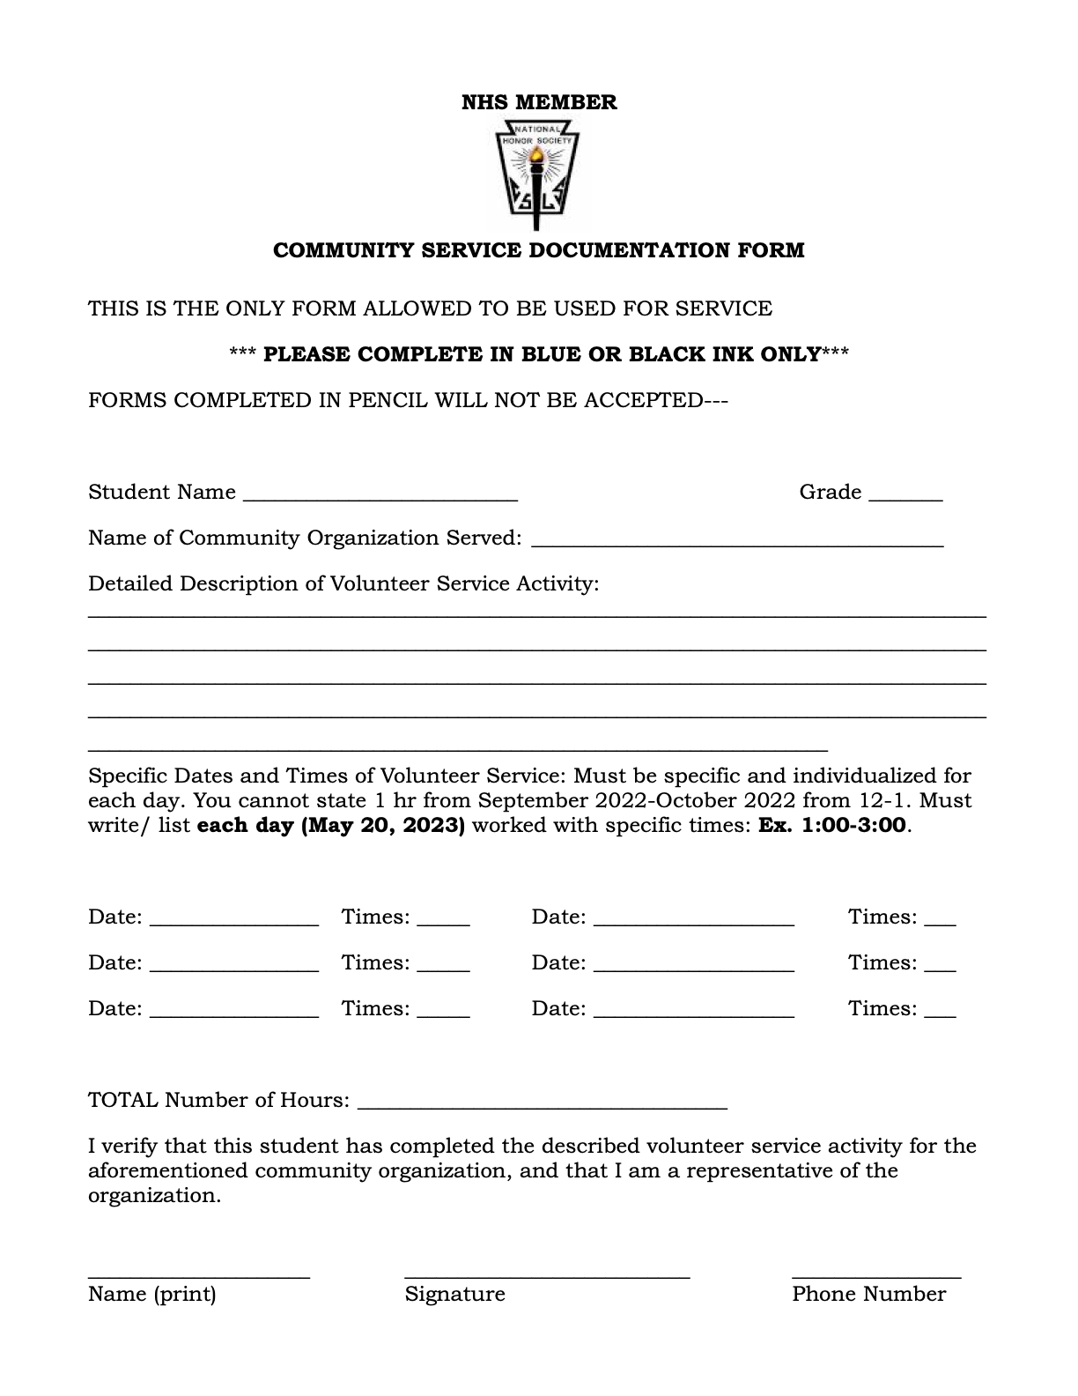
Community Service Form:
Linked on the JC website → Clubs and Organizations → NHS

Slide 12
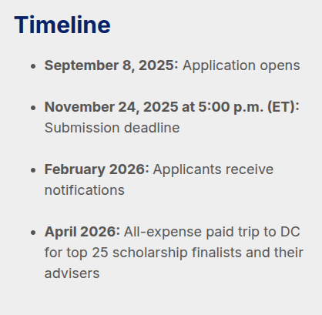
Seniors - NHS Scholarship
Keep an eye out for these dates if you applied
nationalhonorsociety.org

Slide 13
Volunteer in the Garden- Huntsville Botanical Garden
Weekdays (daytime, evenings), Weekends (daytime, evenings)
Volunteer opportunities vary in length of time based on the availability of the individual as well as the task or event chosen.
Community Development, Environment & Sustainability
Participation Requirements: Attend Orientation
Age Requirement: 16+
Volunteer Application Link:
https://ideali.st/qXWh8n

Slide 14
Huntsville Animal Services
Volunteers needed any time the shelter is open
Monday-Friday (9am - 5pm), Saturday (9am - 3pm)
Volunteers can choose to help with activities with or without direct contact with animals.
Volunteers must be at least 16 years of age, and those under 18 need a consent form from a guardian.
Application Link:
www.huntsvilleal.gov/

Slide 15
Manna House Food Distribution Center
Assist with food preparation and distribution, clothing distribution, etc. for the less fortunate on Mondays, Wednesdays, and Thursdays from 1:00pm-6:30pm.
Help set up and serve at outdoor church events for the less fortunate on Saturdays from 11:00am-1:00pm.
Always in need of toilet paper and grocery bag donations.
More information can be found at: https://mymannahouse.com/get-involved/

Slide 16
Free 2 Teach
Job #1: “Assist with Teacher Shopping” - help teachers with their shopping, check them in and out, restock school supplies and other goods for teachers.
Tuesdays & Thursdays 3:00pm-6:00pm
1st Saturday of every month during the school year 9:00am-12:00pm
You MUST register as a volunteer with Free2Teach and register for a shift via the Free2Teach website
Sign Up Link + More Information: https://free2teach.org/impact/volunteer/

Slide 17
Downtown Rescue Mission Thrift Store
Come ANYTIME between 9am - 7pm to volunteer your time organizing and reshelving clothing, tidying up, and helping the community.
Volunteers are in greater need on Specialty days (Half-price, Super Saturdays, etc.)
Upon arrival, ask a cashier for the Volunteer book and sign in.
https://www.downtownrescuemission.org/thrift-stores

Slide 18
ShowerUp
Help those experiencing homelessness by providing showers, hygiene resources and personal care.
Volunteers can do a variety of things such as: handing out hygiene kits, cleaning showers, assigning people showers, and washing towels.
Location: Rose of Sharon Soup Kitchen - 723 Arcadia Cir NW Huntsville AL 35801
You must sign up to be a volunteer through their website before signing up for events
Check their website for when volunteering hours are available.

Slide 19
Merrimack Hall
Volunteers assist with art classes of all sorts catered towards special needs youth within the Huntsville area.
Classes to help with include: pottery, dance, fitness, music, games, acting, yoga, art, and more.
Location: Merrimack: 262 Miller Lane Owens Crossroads AL 35763
Check out their website for more information on how to sign up
Link: https://merrimackhall.com/

Slide 20
GHHS Dog Ball
Help out with the GHHS Dog Ball by assisting with

Slide 21

Workshop: Financial Literacy

Slide 22
Financial Literacy Tips
Budgeting
Credit vs Debit

Slide 23



Budgeting
Your budget is based on your needs and wants, with more emphasis on your needs. Needs are essential for your survival, while wants enhance life. Emergency Funds - When budgeting, always make sure to allocate a portion of your funds to saving up your emergency fund. Your emergency fund should be around 2-3 months worth of expenses. Your budget should be based off of your lifestyle (Drake “Drake Maye” Maye might spend more on food than Stephen Hawking, but Stephen Hawking might spend more on physics textbooks than Drake “Drake Maye” Maye).
Budgeting is the practice of planning how your money is earned and spent to ensure financial stability.
It helps individuals understand their spending, set clear priorities, and make responsible financial choices.

Slide 24



Imperial Military Commander In Chief - $300,000 / Year
$200,000 Porsche Carrera T Convertible
$300,000/year → $25,000/month It is recommended that 10-12% of your monthly income is dedicated to car payments. The monthly payment on the Porsche is around $3750 The monthly payment on the Audi is around $2667
$160,000 2022 Audi R8

Slide 25


Credit Cards vs Debit Cards
When you use a credit card, you take a loan from the bank. Credit cards are best used for planned purchases that can be paid off in full, as well as for online shopping or travel where extra protection is helpful.
They are also useful when building credit or earning rewards, as long as spending is controlled. Credit Cards do have limits on them. Credit Card debt is very dangerous to have, as interest on this debt is on average 24%
Debit Cards use your own money Debit cards are best for everyday purchases and situations where the expense is not too big.
They are useful when you want to spend only the money you already have and avoid taking on debt.

Slide 26

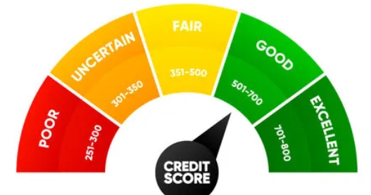
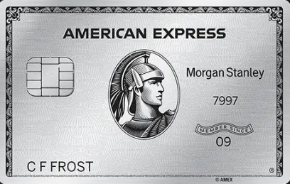

Building Credit and Types of Credit Cards
Building credit requires consistently using credit in a responsible way by making on-time payments on your debts.
A strong credit history improves access to loans, lowers interest rates, and creates more financial options over time. This is because you seem more reliable to banks.
Choosing the right credit card involves comparing interest rates, annual fees, and reward programs to find the best fit.
It is important to select a card that matches personal spending habits and can be paid off in full each month to avoid debt.

Slide 27
January Meeting Password
Please type in all caps.
This is required to submit the attendance form.
Notes:
The January meeting password is: DARTHVADER

Slide 28
Students listed below, please come up to the stage
Kyler Haverty
Daniel Hso
Yashri Patel
Fiona Scully
Savannah Velez

Slide 29
New Members join the ParentSquare Group:
ParentSquare Link: https://www.parentsquare.com/groups/join/nnjxatobtn
Slides will be posted on the NHS club page on the JCHS website
Attendance form posted on ParentSquare and will close at the end of Refuel
Students, if you would like your parents to be included into the ParentSquare, send them the link above.
Notes:
Password: DARTHVADER

